Slide 1


LOUISIANA TEEN READERS’ CHOICE
9th Grade - 12th Grade
2024 - 2025

Slide 2




LTRC IS SPONSORED BY:
Louisiana Chapters of
Delta Sigma Theta
Sorority, Inc.

Slide 3

AND WE RISE
THE CIVIL RIGHTS MOVEMENT IN POEMS
Author:
Erica Martin
You’ve heard the names Martin Luther King Jr. and Rosa Parks, but what about the many other people—and events—that turned moments of injustice into a movement for change?
In spare and evocative verse, Erica Martin’s debut poetry collection walks readers through the Civil Rights Movement—the well-documented events that shaped the nation’s treatment of Black citizens, beginning with the “Separate but Equal” ruling—and introduces readers to lesser-known figures and moments that were just as crucial to the Movement and our nation’s centuries-long fight for justice and equality.
nonfiction | 160p
AR: none as of 9/2024

Slide 4
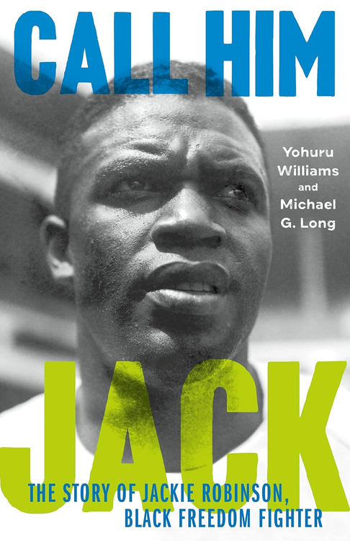
CALL HIM JACK
THE STORY OF JACKIE ROBINSON, BLACK FREEDOM FIGHTER
Author:
Yohuru Williams, Michael G. Long
According to Martin Luther King, Jr., Jackie Robinson was “a sit-inner before the sit-ins, a freedom rider before the Freedom Rides.” According to Hank Aaron, Robinson was a leader of the Black Power movement before there was a Black Power movement. According to his wife, Rachel Robinson, he was always Jack, not Jackie—the diminutive form of his name bestowed on him in college by white sports writers. From two prominent Robinson scholars comes this electrifying biography that recovers the real person behind the legend, reanimating this famed figure’s legacy for new generations, widening our focus from the sportsman to the man as a whole and deepening our appreciation for his achievements on the playing field in the process.
nonfiction | 240p
AR: none as of 9/2024

Slide 5
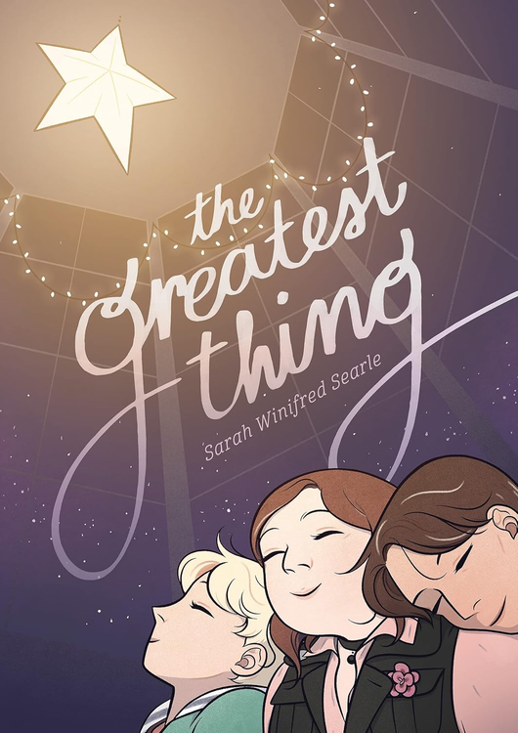
THE GREATEST THING
Author:
Illustrator:
Sarah Winifred Searle
Sarah Winifred Searle
It’s the first day of sophomore year, and now that Winifred’s two best (and only) friends have transferred to a private school, she must navigate high school on her own.
But she isn’t alone for long. In art class, she meets two offbeat students, Oscar and April. The three bond through clandestine sleepovers, thrift store shopping, and zine publishing. Winifred is finally breaking out of her shell, but there’s one secret she can’t bear to admit to April and Oscar, or even to herself—and this lie is threatening to destroy her newfound friendships.
graphic novel | 352p
AR: none as of 9/2024

Slide 6

I MUST BETRAY YOU
Author:
Ruta Sepetys
Romania, 1989. Communist regimes are crumbling across Europe. Seventeen-year-old Cristian Florescu dreams of becoming a writer, but Romanians aren’t free to dream; they are bound by rules and force.
Amidst the tyrannical dictatorship of Nicolae Ceaușescu in a country governed by isolation and fear, Cristian is blackmailed by the secret police to become an informer. He’s left with only two choices: betray everyone and everything he loves—or use his position to creatively undermine the most notoriously evil dictator in Eastern Europe.
Cristian risks everything to unmask the truth behind the regime, give voice to fellow Romanians, and expose to the world what is happening in his country. He eagerly joins the revolution to fight for change when the time arrives. But what is the cost of freedom?
historical fiction | 336p
AR: UG | 4.3 | 8 pts

Slide 7

LOVE RADIO
Author:
Ebony LaDelle
Prince Jones is the guy with all the answers—or so it seems. After all, at 17, he has his own segment on Detroit’s popular hip-hop show, Love Radio, where he dishes out advice to the brokenhearted.
Prince has always dreamed of becoming a DJ and falling in love. But being the main caretaker for his mother, who has MS, and his little brother means his dreams will stay just that and the only romances in his life are the ones he hears about from his listeners. Until he meets Dani Ford.
Dani isn’t checking for anybody. She’s focused on her plan: ace senior year, score a scholarship, and move to NYC to become a famous author. But her college essay keeps tripping her up and acknowledging what’s blocking her means dealing with what happened at that party a few months ago. And that’s one thing Dani can’t do.
When the romantic DJ meets the ambitious writer, sparks fly. Prince is smitten, but Dani’s not looking to get derailed. She gives Prince just three dates to convince her that he’s worth falling for. Three dates for the love expert to take his own advice, and just maybe change two lives forever.
romance | 320p
AR: none as of 9/2024

Slide 8
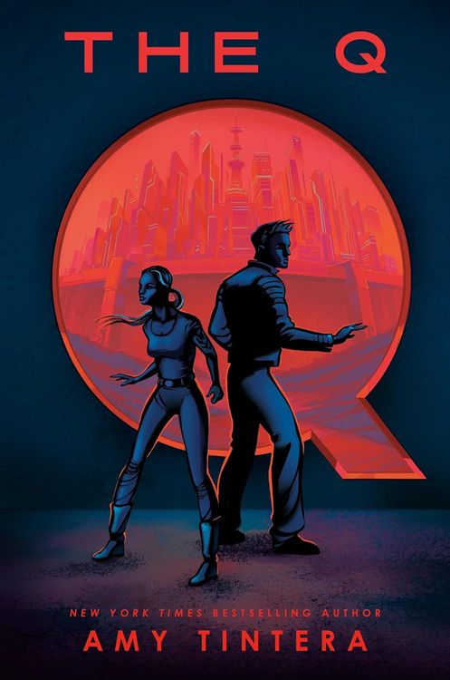
THE Q
Author:
Amy Tintera
Seventeen-year-old Maisie Rojas has spent her entire life in the Q—a post-pandemic quarantine zone that was once Austin, Texas. Born and raised behind the high security walls that sealed their fate, she's now a trusted lieutenant for one of the territory's controlling families.
Lennon Pierce, the charismatic son of a US presidential candidate, has just been kidnapped by his father's enemies and dropped out of a plane into the Q with nothing but a parachute strapped to his back. Lennon is given a temporary antidote to the disease and crucial intel for his father, but Maisie must get him out of the zone within forty-eight hours--or he will be permanently infected and forced to remain.
With unrest brewing both inside and outside the Q, reaching the exit is a daunting and dangerous task. But if Maisie and Lennon fail, it could mean disaster for the entire quarantine zone and its inhabitants—and could cost Lennon his life.
dystopian | 352p
AR: none as of 9/2024

Slide 9
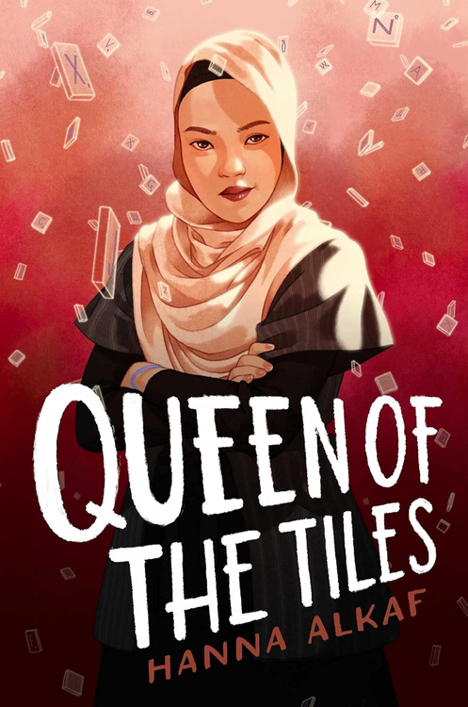
QUEEN OF THE TILES
Author:
Hanna Alkaf
CATALYST - 13 points - noun: a substance that speeds up a reaction without itself changing
When Najwa Bakri walks into her first Scrabble competition since her best friend’s death, it’s with the intention to heal and move on with her life. Perhaps it wasn’t the best idea to choose the very same competition where said best friend, Trina Low, died. It seems that even though Najwa is trying to change, she’s not ready to give up Trina just yet.
But the same can’t be said for all the other competitors. With Trina, the Scrabble Queen herself, gone, the throne is empty, and her friends are eager to be the next reigning champion. All’s fair in love and Scrabble, but all bets are off when Trina’s formerly inactive Instagram starts posting again, with cryptic messages suggesting that maybe Trina’s death wasn’t as straightforward as everyone thought. And maybe someone at the competition had something to do with it.
As secrets are revealed and the true colors of her friends are shown, it’s up to Najwa to find out who’s behind these mysterious posts—not just to save Trina’s memory, but to save herself.
mystery | 304p
AR: MG+ | 5.3 | 11 pts

Slide 10

THE SACRIFICE
Author:
Rin Chupeco
Alon, a local teenager, watches a production crew of an American documentary-style reality show set up on Kisapmata (called the "Godseye" by the Americans), an island off the coast of the Philippines rumored to be cursed. Two producers offer to pay them to be the crew's tour guide since other locals have refused to set foot on the island.
Within minutes of their arrival, a sinkhole appears, revealing a mummified corpse entwined within a balete tree growing underground. Rattled, the showrunner explains to Alon the purpose of the show: to investigate the island's legend of a Dreamer god that supposedly grants believers unspeakable powers in exchange for eight sacrifices.
A mysterious journal they find on the island lends credit to the curse and poses a sinister riddle: He who sleeps in the mouth is He who sleeps in the eye. The first to eat, the second to seed, the third to wear, the fourth to birth, the fifth to serve, the sixth to lure, the seventh to consume, the last to wake. The roles of each seem to align with the known sacrifices.
As the crew falls victim to the island's curse one-by-one, Alon must figure out a way to stop the Dreamer before it destroys more than just the island.
horror | 304p
AR: none as of 9/2024

Slide 11

THE SUNBEARER TRIALS
Author:
Aiden Thomas
As each new decade begins, Sol selects the ten most worthy semidioses to compete in The Sunbearer Trials. The winner carries light and life to all the temples of Reino del Sol, but the loser will be sacrificed to refuel the Sun Stones, protecting the world for another ten years.
Teo, 17-year-old trans son of the goddess of birds, isn't worried about being chosen. The trials are only for Heroes, and he isn't one. But then, for the first time in over a century, Sol chooses semidioses who aren't established Heroes: Xio, the 13-year-old child of Mala Suerte, god of bad luck, and . . . Teo. Now they must compete in five mysterious trials, against opponents who are more powerful and better trained, for fame, glory, and their own survival.
fantasy | 416p
AR: UG | 5.9 | 19 pts

Slide 12

YOU, ME, AND OUR HEARTSTRINGS
Author:
Melissa See
Daisy and Noah have the same plan: use the holiday concert to land a Julliard audition. But when they're chosen to play a duet for the concert, they worry that their differences will sink their chances. Noah, a cello prodigy from a long line of musicians, wants to stick to tradition. Daisy, a fiercely independent disabled violinist, is used to fighting for what she wants and likes to take risks. But the two surprise each other when they play. They fall perfectly in tune.
After their performance goes viral, the rest of the country falls for them just as surely as they're falling for each other. But viral fame isn’t all it’s cracked up to be. No one seems to care about their talent or their music at all. People have rewritten their love story into one where Daisy is an inspiration for overcoming her cerebral palsy and Noah is a saint for seeing past it.
Daisy is tired of her disability being the only thing people see about her, and all of the attention sends Noah’s anxiety disorder into high speed. They can see their dream coming closer than it’s ever been before. But is the cost suddenly too high?
romance | 320p
AR: UG | 4.9 | 9 pts

